Slide 1
mixup: Beyond Empirical Risk Minimization, ICLR2018
COMPUTER VISION LAB
22211226 JHNam

Slide 2
CONTENT
Introduction
Method
Experiments

Slide 3

Introduction
Characteristic of Neural Networks
1. They are trained as to minimize their average error over the training data.
= Empirical Risk Minimization(ERM) principle(learning rule)
2. The size of these SOTA NNs scales linearly with the number of training examples.
Training dataset ↑ $→$ Convergence of ERM is guaranteed
Vapnik and A. Y. Chervonenkis. On the uniform convergence of relative frequencies of events to their probabilities. Theory of Probability and its Applications, 1971.

Slide 4
Introduction
Empirical Risk Minimization
Choosing a model with low loss for training data.
ERM → Memorize the training data even in the presence of strong regularization or in classification problems where the labels are assigned at random.
Zhang, S. Bengio, M. Hardt, B. Recht, and O. Vinyals. Understanding deep learning requires rethinking generalization.
NN with ERM → weak to out of training distribution data point
Szegedy, W. Zaremba, I. Sutskever, J. Bruna, D. Erhan, I. J. Goodfellow, and R. Fergus. Intriguing properties of neural networks. ICLR 2014.
→ ERM is unable to explain or provide generalization in testing distributions that differ only slightly from the training data…
However, there is no alternative way to train NNs

Slide 5
Introduction
Vicinal Risk Minimization Principle
The objective is to appropriately model the vicinity distribution of empirical data and to minimize the risk of this data distribution.
To achieve VRM, virtual examples can be drawn from the vicinity distribution of the training examples to enlarge the support of the training distribution.
Horizontal reflection, slight rotations, mild scaling… → Data Augmentation(DA)
DA → generalization of NNs ↑

Slide 6
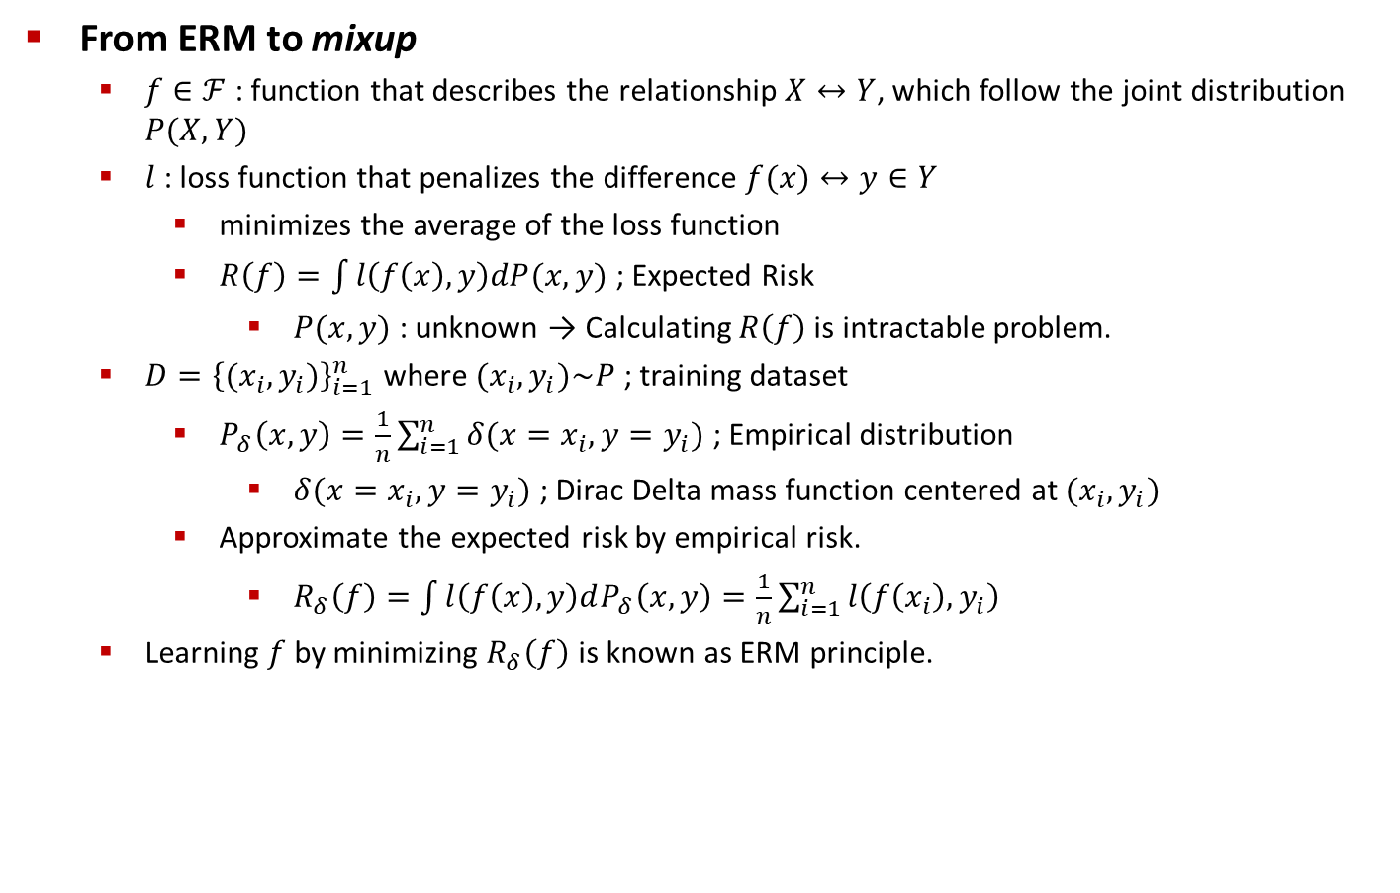
Method
From ERM to mixup
$f∈ℱ$ : function that describes the relationship $X↔Y$, which follow the joint distribution $P(X, Y)$
$l$ : loss function that penalizes the difference $f(x)↔y∈Y$
minimizes the average of the loss function
$R\left(f\right)=\int{l\left(f\left(x\right), y\right)dP(x,y)}$ ; Expected Risk
$P(x,y)$ : unknown → Calculating $R\left(f\right)$ is intractable problem.
$D={\left\{(x_{i},y_{i})\right\}}_{i=1}^{n}$ where $(x_{i},y_{i})\sim P$ ; training dataset
$P_{δ}\left(x, y\right)=\frac{1}{n}\sum_{i=1}^{n}{δ(x=x_{i},y=y_{i})}$ ; Empirical distribution
$δ(x=x_{i},y=y_{i})$ ; Dirac Delta mass function centered at $(x_{i},y_{i})$
Approximate the expected risk by empirical risk.
$R_{δ}\left(f\right)=\int{l\left(f\left(x\right), y\right)dP_{δ}\left(x, y\right)}=\frac{1}{n}\sum_{i=1}^{n}{l\left(f\left(x_{i}\right),y_{i}\right)}$
Learning $f$ by minimizing $R_{δ}\left(f\right)$ is known as ERM principle.

Slide 7
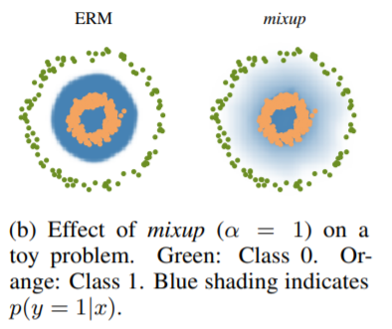

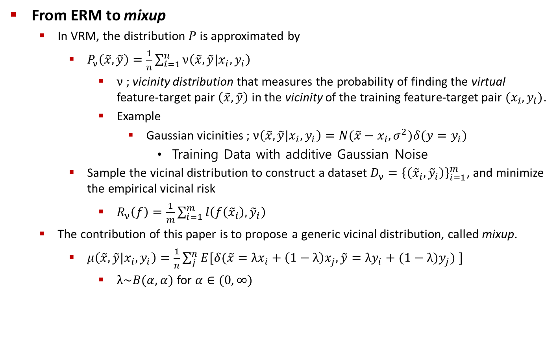
Method
From ERM to mixup
In VRM, the distribution $P$ is approximated by
$P_{ν}\left(\tilde{x},\tilde{y}\right)=\frac{1}{n}\sum_{i=1}^{n}{ν\left(\tilde{x},\tilde{y}|x_{i},y_{i}\right)}$
$ν$ ; vicinity distribution that measures the probability of finding the virtual feature-target pair $\left(\tilde{x},\tilde{y}\right)$ in the vicinity of the training feature-target pair $(x_{i},y_{i})$.
Example
Gaussian vicinities ; $ν\left(\tilde{x},\tilde{y}|x_{i},y_{i}\right)=N(\tilde{x}−x_{i},σ^{2})δ(y=y_{i})$
Training Data with additive Gaussian Noise
Sample the vicinal distribution to construct a dataset $D_{ν}={\left\{\left({\tilde{x}}_{i},{\tilde{y}}_{i}\right)\right\}}_{i=1}^{m}$, and minimize the empirical vicinal risk
$R_{ν}\left(f\right)=\frac{1}{m}\sum_{i=1}^{m}{l\left(f\left({\tilde{x}}_{i}\right),{\tilde{y}}_{i}\right)}$
The contribution of this paper is to propose a generic vicinal distribution, called mixup.
$μ\left(\tilde{x},\tilde{y}|x_{i},y_{i}\right)=\frac{1}{n}\sum_{j}^{n}{E[δ(\tilde{x}={λx}_{i}+\left(1−λ\right)x_{j}, \tilde{y}={λy}_{i}+(1−λ)y_{j}) ]}$
$λ\sim B(α,α)$ for $α∈(0, ∞)$

Slide 8
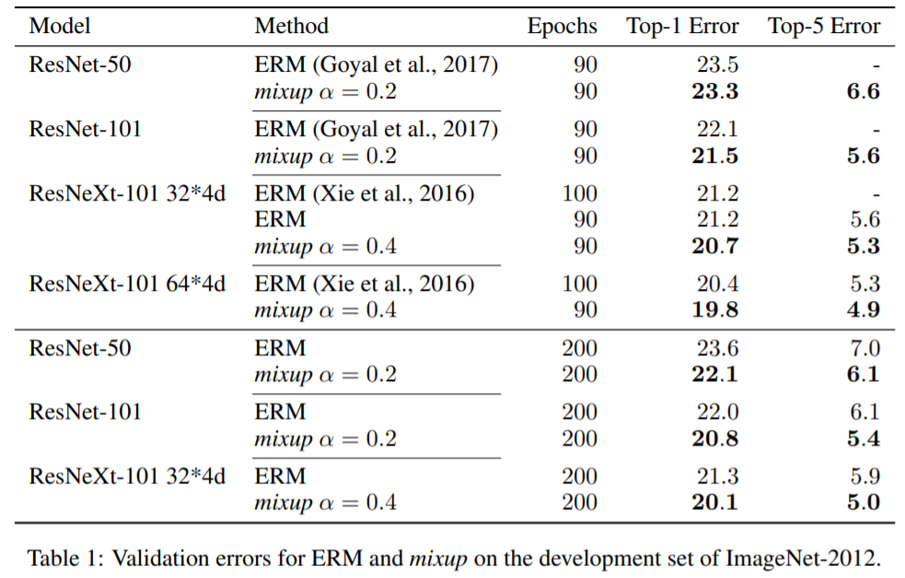
Experiments
ImageNet Classification

Slide 9
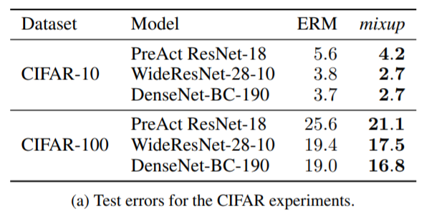
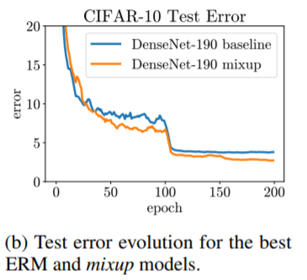
Experiments
CIFAR10/CIFAR100 Classification

Slide 10
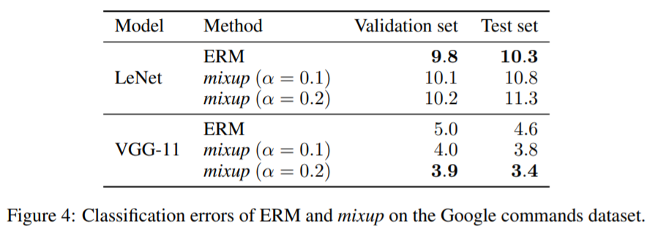
Experiments
Speech Data Classification

Slide 11
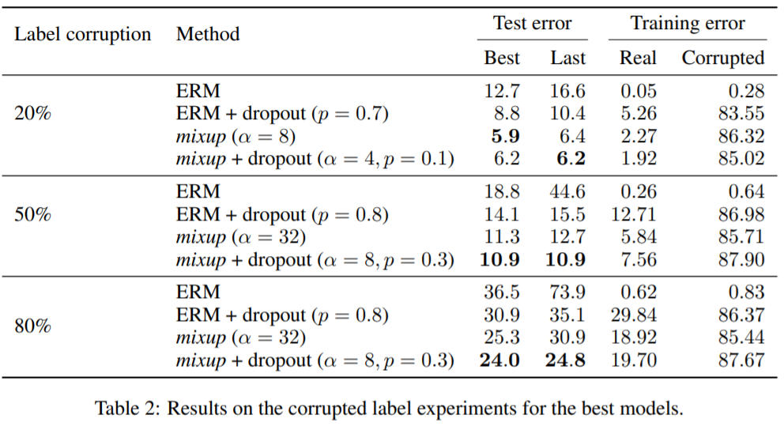
Experiments
Memorization of Corrupted Labels

Slide 12
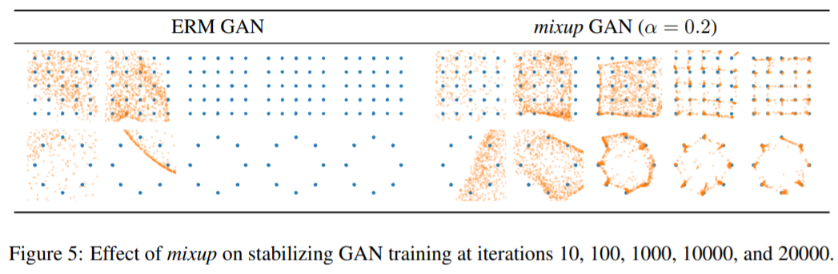
Experiments
Stabilization of GAN

